Slide 1
System Software
AS2 | Mr Butler

Slide 2
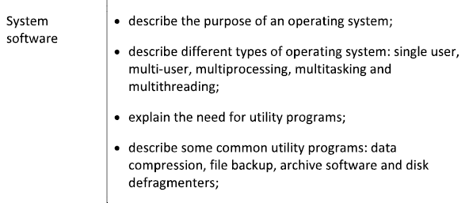
The Spec

Slide 3
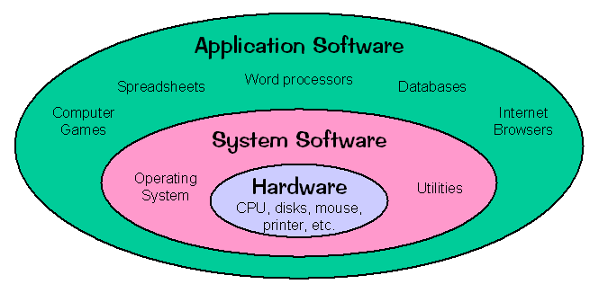
What IS an operating system?
An Operating system is the software that controls the hardware and creates a user interface to run application software.
An operating system (or OS) is a computer program, which controls the entire operation of the computer.
The function of system software is to control the computer hardware and to create a platform to run application software.

Slide 4
Why do we need an operating system?
An operating system is the most important software that runs on a computer. It manages the computer's memory and processes, as well as all of its software and hardware.
It also allows you to communicate with the computer without knowing how to speak the computer's language.
Without an operating system, a computer is useless

Slide 5
Why an Operating System?
Allocating Memory
  The OS organises the use of main memory between programs and data files
  Data needs to be transferred from a HDD/SSD to main memory (i.e. RAM) before it can be used.
  Locates free memory in RAM and allocates this to the program/file
Storage
  The OS manages the storage of data and files
  Unnecessary files can then be deleted
Processing Time
  System software allocates processing time between running programs and the users.
  Uses time slices. More important task gets more time slices.
  System performance includes response time and processor usage.
    Monitored by the system software
Security
Memory managment
Multi-tasking
Peripheral management
User interface
Operating System

Slide 6
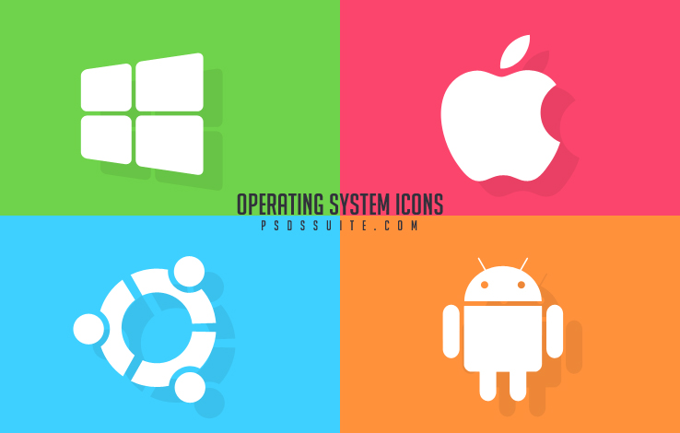
Quick Task: Different Operating Systems
In pairs, list as many operating systems as you can.

Slide 7
Types of Operating System
There are multiple types of operating system about – some are more common than others. Below are some of the more common types:
  Single User
    Working from home on your PC
    it has one keyboard and one screen to support user interaction
    If another user needs to access the device they must wait until the person currently using the device finished their task
    the operating system is designed so that one user can effectively do one thing at any one time.
    Some older mobile phone devices operated on this principle,
      for example consider how it might only have been possible to perform one task at a time on older devices so being able to listen to music and surf the internet at the same time would not have been possible on a single user, single-task OS
  Multi-tasking
While most PC’s will effectively support multitasking by a single user, there are times when more than one user may need to gain access to the facilities provided by a much more powerful computer,
  for example in a university setting where many chemical reactions are being monitored at the same time or in the stock exchange where many individuals are monitoring stocks and shares across the world.
In these instances a multi-user operating system will support use of the computers facilities by many different users at any one time; generally via a network.
In a multi-user OS it is important that all user requests are dealt with in such as way so as to ensure that they do not interfere with each other.
The OS must share the devices effectively to ensure that all tasks are processed effectively.
Where many processing tasks are being carried out simultaneously, a multiuser system must also ensure that processor time is shared between each user and a process known as time-slicing may sometimes be implemented.

Slide 8
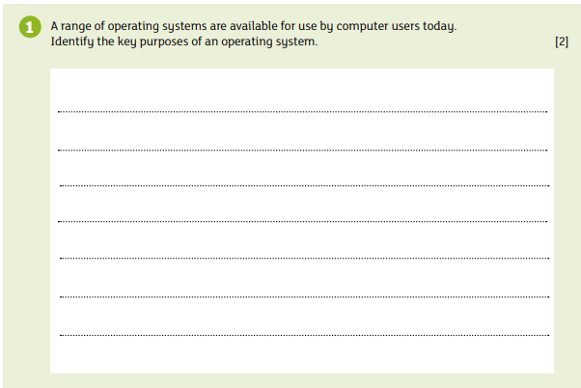

Slide 9
Fact File 1: Mark Scheme
Manages resources such as hardware and software (drivers/Storage/Etc) [1]
Allocates Memory/ memory management [1]
Handles user input and output [1]
Provides an interface for the user [1]
Ensures the computer is secure via scheduling security software [1]

Slide 10

Activity:
Go to http://www.ni.com/white-paper/6424/en/
List the differences between Multithreading and Multitasking operating systems

Slide 11
Multiuser
More than one user is logged on and can use the computer at any one time
Each person needs to be able to run more than one application at a time, so needs to be multi-tasking as well
Each person can draw the power of the computer in a shared way, allowing multiple users to run multiple programs simultaneously
  Can be a few users -> 1000’s of users
The OS needs to keep track of where each person is with each program and be able to switch between one task to another without losing data
Each user in turn is given a small time slice of the CPU time.
Because these time slices are very small the users believe that they are all using the mainframe at the same time.
Multi-user operating systems rely on having very powerful computers to process data.

Slide 12
Multi-tasking
Interrupts & Jump Cycles
When computers switch between running programs, they need to change the contents of the CPU. This is where the program counter performs a ‘jump cycle’ and changes its content to the new program.
A multi-tasking operating system is capable of appearing to carry out more than one task at a time.
Windows 7/10 are examples of a multi-tasking operating systems.
If you have a computer with a multi-tasking OS you could be using a spreadsheet and a word processor at the same time.
Most multi-tasking operating systems have a WIMP user interface with each task being displayed in its own window.
https://www.youtube.com/watch?v=mINZ-YFO88c&feature=youtu.be

Slide 13
Features of a Multi-tasking System
Enables the user to perform more than one task/program at a time
Each task may have its own window
Each task can be totally independent of each other
The tasks may be dependent e.g. they may share data
The OS allocates storage and other resources accordingly
In pre-emptive multitasking, the OS allocates CPU time slices to each program/task
In cooperative multitasking, each program has use of the CPU for as long as it needs

Slide 14
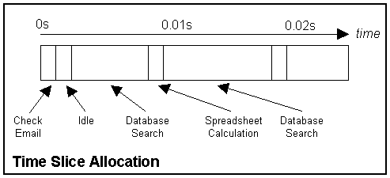
How Multi-tasking Works
In reality because the computer only has one processor it can only be doing one thing at once.
The computer fools you into thinking it is doing more than one task at once by dividing the processor time up between each of the tasks.
Each task is given a small amount of processor time in turn
The amount of time allocated to a task is known as a time slice. These time slices are very short, usually less that 1/1000 of a second.
Because the slices are so small, the user is fooled into thinking that the computer is doing many things at once.

Slide 15
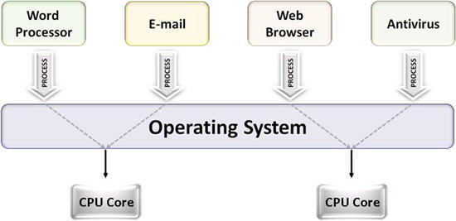
Multi-processing
Multiprocessing sometimes refers to executing multiple processes (programs) at the same time.
In fact, multiprocessing refers to the hardware (i.e., the CPU units) rather than the software (i.e., running processes). If the underlying hardware provides more than one processor then that is multiprocessing.

Slide 16
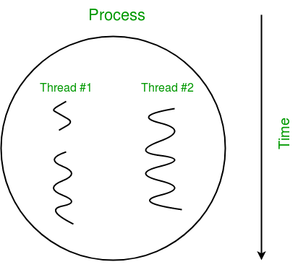
Multi-threading
The ability of an operating system to execute different parts of a program, called threads, simultaneously. The programmer must carefully design the program in such a way that all the threads can run at the same time without interfering with each other.

Slide 17
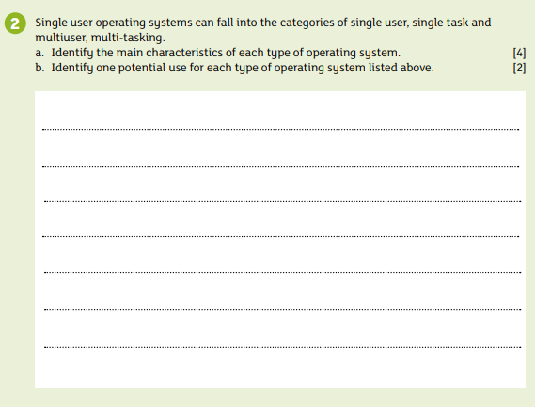

Slide 18
Fact File 2: Mark Scheme
Single User:
  Provides access to the computer for any one user at any given time
    Has one keyboard and monitor to support user interaction
    If another person wants access they will have to wait until the user is finished to use the device
    Potential Use: A home computer/device
Single Task:
  The OS can only deal with one task/application at any given time
  The user will have to finish the task before opening something else
    Potential Use: An old mobile device works on this principle. i.e. can’t listen to music + browse the internet

Slide 19
Fact File 2: Mark Scheme
Multi-User:
  Enables many users to run programs simultaneously
  The OS must make sure that resources allocated to the current users are balanced
  … so the user has sufficient resources
  … time slicing is used to ensure overall performance of the system is satisfactory
  Potential Use: Many users accessing a travel website to book flights at the same time
Multi-tasking:
  Allows the user to perform more than one task at a time
  The OS allocates storage and other resources accordingly as it needs to keep track of where users are in these tasks
  Allocates time slices to each program/task
  Potential Use: having a browser and word processing software at the same time

Slide 20
✓
✓

Slide 21
Utility Programs – What are they?
A utility program is a system program that performs a specific task related to the management of computer functions.
It is provided by the OS to help the user manage their computer and ensure that it operates effectively.
A utility program may be designed to do one or two tasks well and nothing else
For example:
  file backup,
  data compression (i.e. winzip),
  archive software, and
  disk defragmenters.

Slide 22
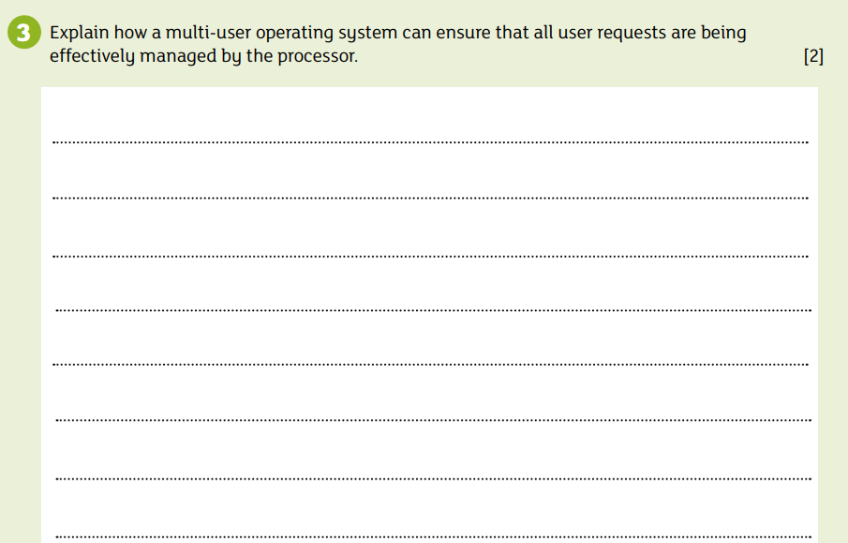

Slide 23
Fact File 3: Mark Scheme
Sharing devices and resources effectively to ensure all tasks are properly balanced and the user has sufficient resources while the overall performance of the system is satisfactory [1]
Processing time is also shared between each user known as time slicing [1]
Each user is given a time slice by rotating the CPU’s time around the terminals and processing in short bursts [1]
Each user has the impression that they are the sole user of the system [1]

Slide 24
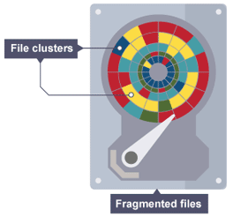
Disk Defragmentation
a utility application which rearranges files on a disc surface to ensure they occupy contiguous locations on the disc surface.
Disc defragmentation removes the ‘white space’ from the surface of the disc, reduces read/write head movement during file read and write actions.
This in turn can increase read/write times.
Drive Head
A computer stores its files on a disk, and even though large disks may not have a single continuous block of empty space to hold a single file, computers ‘break up’ a file into little parts, or fragments
This means that a hard disk has to search for all the fragments until it can recreate the file on screen

Slide 25
Defragmentation
Block in memory
A1 | B3 | A2 | A4 | B2 | A3 | <FREE> | B1 | B4 | <FREE>
A1 | A2 | A3 | A4 | B1 | B2 | B3 | B4 | <FREE> | <FREE>

Slide 26

Data Compression
Compression software stores data in a format which requires less space than usual.
This is particularly useful in communications as it allows devices to transmit or store data in fewer bits.
Data compression is widely used in backup utilities and in archive utilities as the reduction of the file size ensures the backup file or archived data takes up less storage space.

Slide 27

File Backup
backup software is designed to create an exact duplicate of data in the event of file corruption, user error or some other event that leads to data loss.
The file backup utility program may use these copies at a later stage to complete a restore or a recovery procedure in the event of data loss.

Slide 28
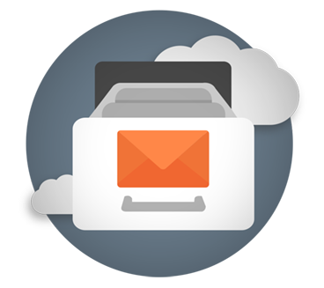
Archiving
an archive utility is an application that can create a single file containing multiple other files.
Additional files can still be added to the archive and existing files can be extracted from the archive file.
An archive file is one containing data no longer in use, but is held for historical purposes, perhaps for auditors. It is often stored away from the computer system in a secure location.

Slide 29
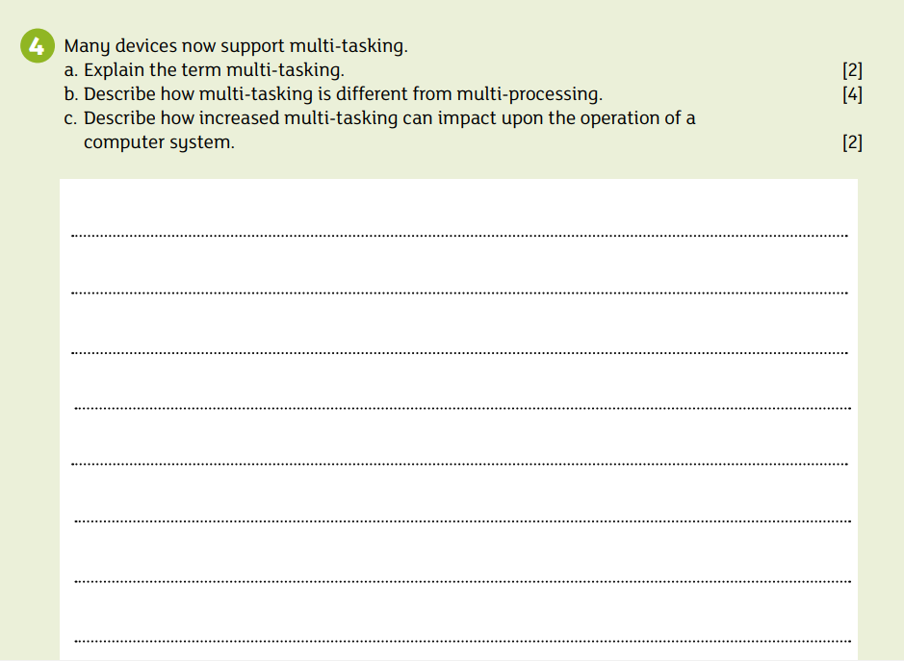

Slide 30
Fact File 4: Mark Scheme
a) Multitasking allows the user to perform more than one task at a time [1]
  i.e. run more than one application program at a time [1]
b) Multitasking is different from multiprocessing as
  Multiprocessing can refer to the use of two or more processors within the same computer system. [1]
  Multitasking is the ability of an OS to execute more than one task simultaneously on a single processor machine [1]
  Where two or more portions of the same program may be carried out simultaneously [1]
  The OS allocates storage and other resources accordingly as it needs to keep track of where users are in these tasks [1]
  More than one task can reside into the same CPU at one point in time [1]
c) Increased multitasking can decrease computer performance [1]
  because when tasks are added the demand on storage and other resources increases meaning the system may slow down. [1]

